Slide 1
Product Tracking System
B.Tech. Project

Slide 2
USE CASE
WAREHOUSE
FRANCHISE 1
FRANCHISE 2
RETAILER 1
RETAILER 2
RETAILER 3
RETAILER 4

Slide 3
OBJECTIVES
?
Traceability
&
Detect Transshipment
Transparency
&
Shared Ledger
Immutability
Security

Slide 4

EXISTING SYSTEM
Warehouse
Ship carton to Franchise
Franchise
Enter retailer details and ship items
Retailer
Scan item and enter location of sale
Register item as sold to Grower

Slide 5
EXISTING SYSTEM
Warehouse
Ship carton to Franchise
Franchise
Ships item to the retailer of choice but enters assigned retailer name
Retailer
Enters a fake location of sale

Slide 6
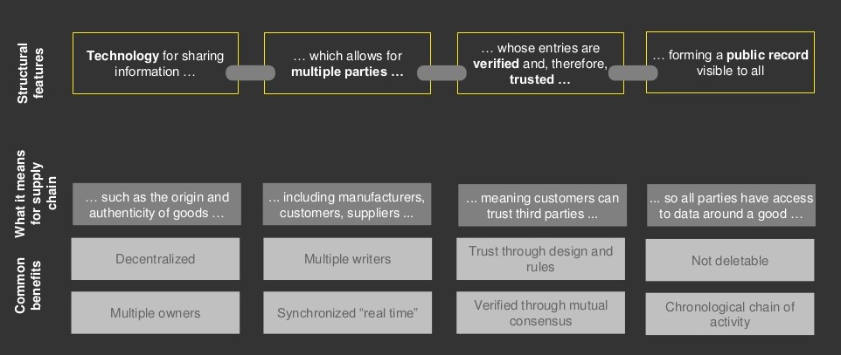
WHY BLOCKCHAIN?

Slide 7







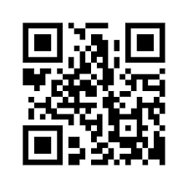
PROPOSED SYSTEM
Business Flow
System Flow
Warehouse | Delivers the Cartons
 | Generates reports
 | Detects anomalies
Franchise | Receive Carton
 | Sends CartonItems
Retailer | Scans product before sale
 | Receives payment from Grower

Slide 8
SYSTEM FLOW
Issue Carton from Warehouse to Franchise & Subscribe to CartonItems(SGTINID)
Issue CartonItem(SGTINID) from Franchise to Retailer
Retailer scans the product QR & the location of sale is stored in Azure DB
Trace the path that the product followed using BlockChain and compare it against the Ideal Path
Detect Anomaly

Slide 9
DEMO

